Slide 1
Welcome to Validate Foundations Leah Sanford
November 2025

Slide 2

Introductions
Hi, I’m (NAME), from (UNIVERSITY).
I’m here mostly to (THE GOAL YOU HAVE).
I’m working on some interesting things. The idea is (INNOVATION) so (USER) can (SOLUTION).

Slide 3


Today
The Course
Risks
A little bit of Customer Discovery

Slide 4
Objectives of course
Introduce
Help
Develop
Develop
Motivate
Introduce you to entrepreneurship principles.
Help you understand, manage and overcome risks.
Develop customer discovery skills.
Develop your value proposition.
Motivate you to continue the journey.

Slide 5

Entrepreneurship options
There are many paths to choose from, and they’ll often intersect
Notes:
Entrepreneurship has many paths:
Building a company and sell it
- Build an sell yet with keeping the rights

Slide 6




Entrepreneurship principles
Risk vs. Reward
Manage the risks – reap the rewards
Customer discovery and validation is key
From your customer insights comes a powerful Value Proposition
Notes:
The risk management has the max responsibility in it

Slide 7
Risks

Slide 8









Sources of Risk
Technical/ Scaling
Market
Management
Revenue/ Sustainability
Financial
Operational
Notes:
If market doesn’t want your product you have to change sth about it to make it ready
You have to know in what scale your product is going to be acceptable and usable
For the management section you have to know the structures and your team
Financial section is the wing for your product to grow

Slide 9









Is there a problem?
Does the problem need a (new or different)
solution?
Market Risk
How big is the problem?
How is it being dealt with now?
Why is that suboptimal?

Slide 10






How big is the problem (aka Market size)
TOP-DOWN APPROACH – SIZE OF INDUSTRY – SIZE OF MARKET
BOTTOM-UP APPROACH – “THIS IS HOW MANY PEOPLE HAVE TOLD ME”
GEOGRAPHIC APPROACH
DEMOGRAPHIC APPROACH (7% OF THE POPULATION)
HOW MUCH MONEY IS INVOLVED?
Notes:
To sell your solution to the companies at first you have to put away your solution on the shelf and talk with them. Get them know better and ask them question and somehow lead them to the fact that you have a solution for them. Then you can offer them your way and sell it.

Slide 11









Does it work?
At what scale does it work?
Technical Risk
Will it work in a way that customers want it to work?
Will it be safe?
Are regulatory approvals needed?

Slide 12
Fundamental equation: Lifetime value of customer – Cost of customer acquisition (COA)

Slide 13





Remember Economic buyers (day one)
How much money is the problem costing them?
How much money?
What are the impacts of the problem? What are those costs?
What are the savings? How can we place a value on efficiency savings?
How easy would it be to access this money?

Slide 14




How easy to access this money?
Is it selling into Government?
Is it selling into large companies?
Is it selling into consumers?
What is the cost of client acquisition?
Notes:
Government are considered as life time customers yet slow payers. On the other hand consumers are fast costumers yet cheap ones.

Slide 15


Management risk
Notes:
It means putting the right people on the right things.

Slide 16





Effectiveness v Efficiency
YOU NEED TO DO THE RIGHT THINGS AND NOT WORRY ABOUT DOING THINGS THE RIGHT WAY
FOCUS ON OUTCOMES
AVOID VANITY METRICS
MANY OF US ARE EFFICIENCY DRIVEN – STARTUP LIFE MAY NOT SUIT
AS YOU EVOLVE – YOU WILL NEED MORE EFFICIENCY DRIVEN PEOPLE

Slide 17


Be in the outcomes business

Slide 18




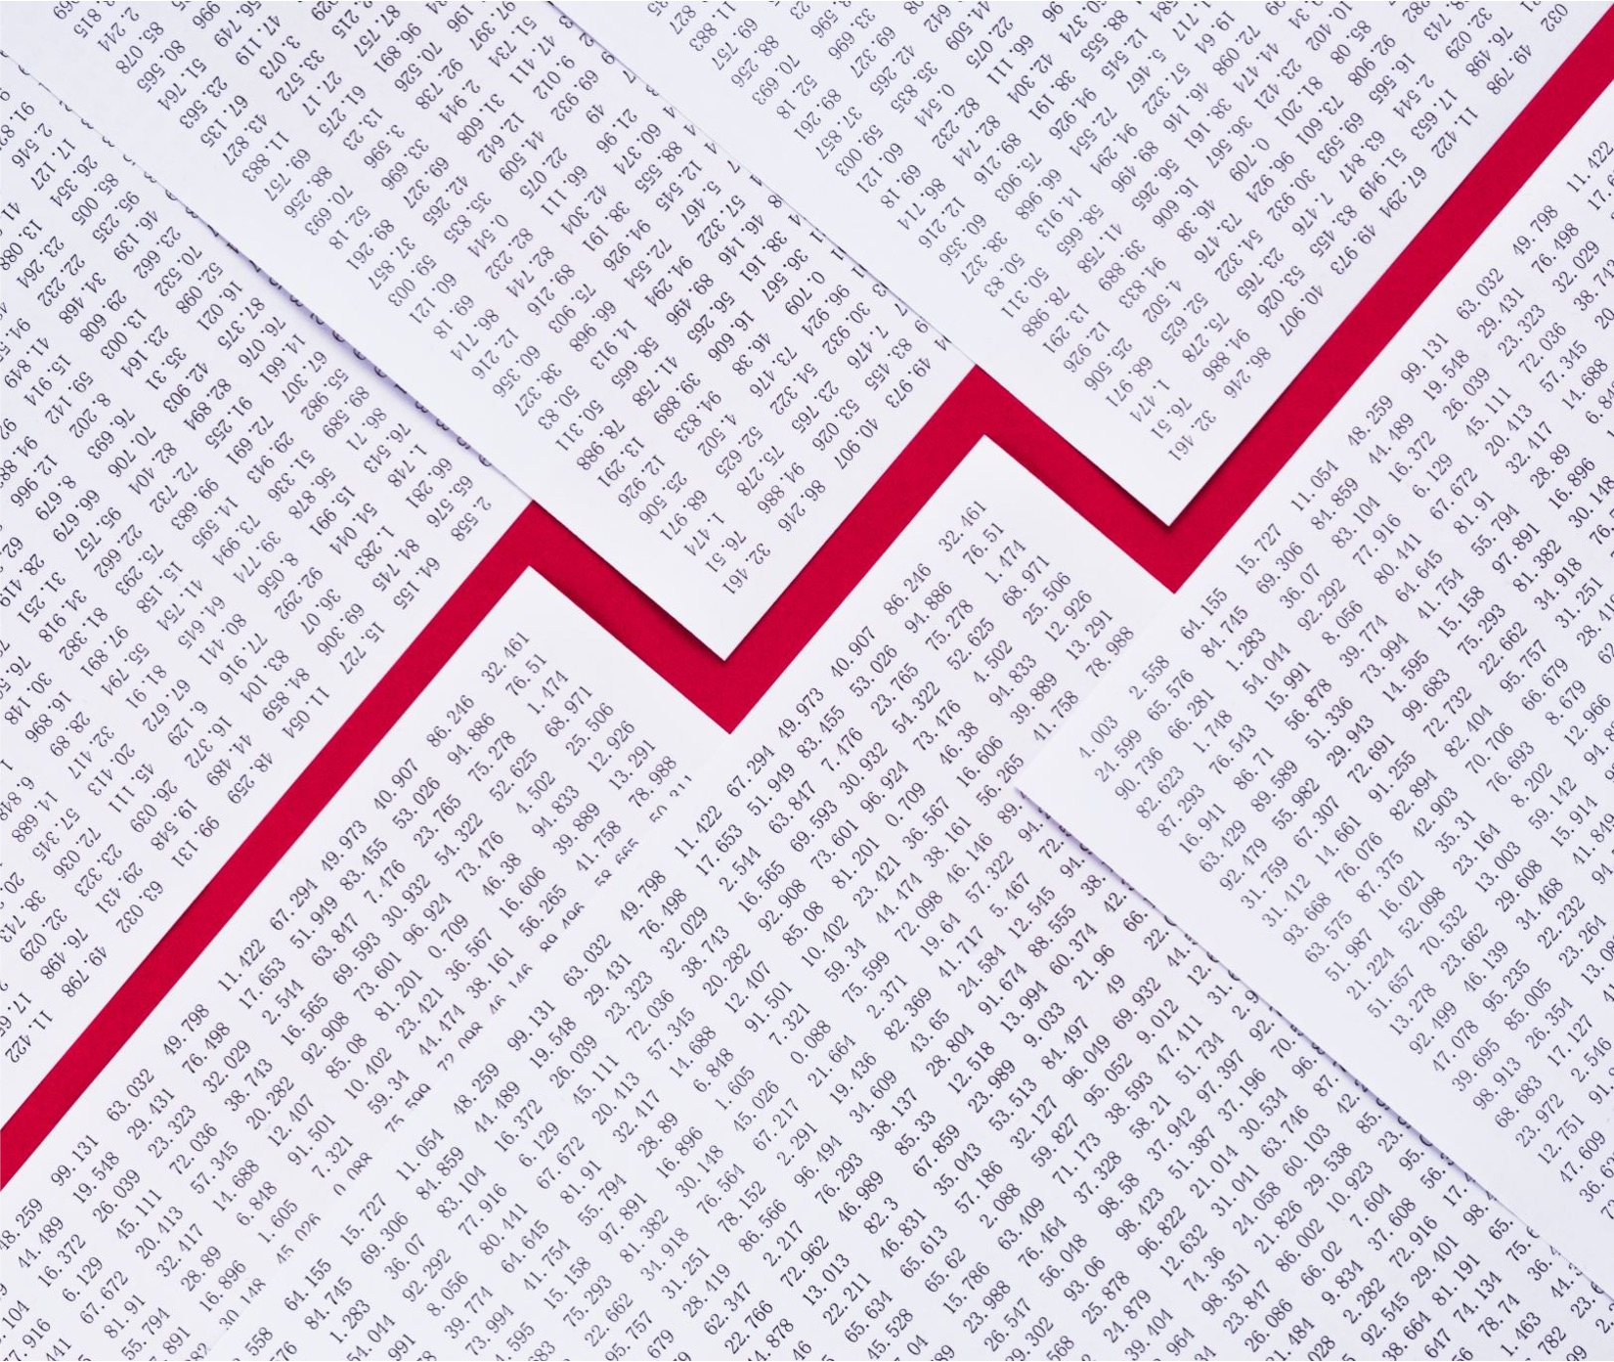
Financial risk

Slide 19
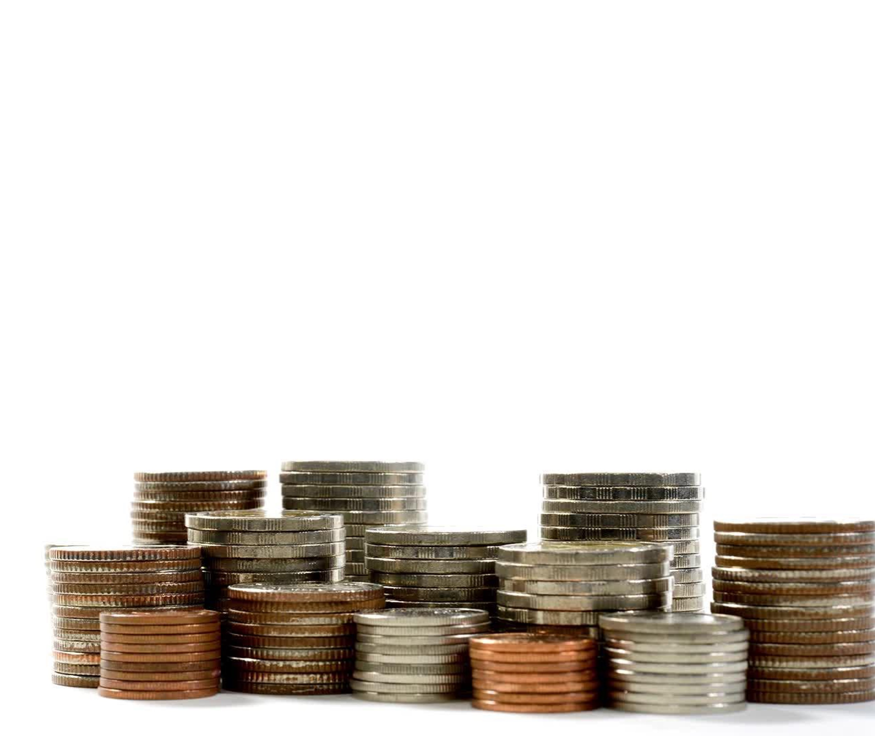
Sales, Profit, Cash
“sales is vanity, profit is sanity but only cash is
reality”
Notes:
Important quote

Slide 20




Cash v Profit
Effectiveness is about cash and only cash
Many companies that fail are profitable
You should only worry about cash – and investors know this

Slide 21









Will you run out of money?
Will you get to a milestone before you next need to raise money?
Liquidity Risk
If yes, justifies a higher valuation, if no lower or same valuation
Need to raise enough money to get you to next milestone.
Investors want to invest in ever increasing valuations (risk is lower as is reward)

Slide 22


Liquidity risk: Don’t run out of money

Slide 23












Angel investors
SAFE/ Convertible loan notes
Pre and Post money valuations Equity
Finance terms
Cap table
Seed investment VC
Preferred shares
Notes:
🧑‍🚀 Angel Investors
Imagine you’re building a cool LEGO rocket but you don’t have enough pieces. An angel investor is like a kind grown-up who gives you LEGO pieces (money) to finish your rocket because they believe it will be awesome!
💸 SAFE / Convertible Loan Notes
These are special promises. You tell your helper (the angel) “If my rocket works and becomes famous, I’ll give you some rocket shares instead of just giving your LEGO pieces back.” That’s what a SAFE or convertible loan note does — it turns help (money) into ownership later.
💰 Pre- and Post-Money Valuation
Think of your rocket before and after you add more LEGO pieces:
Pre-money is how cool and valuable your rocket is before getting new pieces.
Post-money is how valuable it is after adding them.
📊 Equity
Equity means owning a part of something. If your rocket has 10 LEGO pieces and you own 6 of them, you own 60% of the rocket!
📋 Cap Table
A cap table is like a scorecard that shows who owns how many LEGO pieces of the rocket. It helps everyone know who owns what share.
🌱 Seed Investment
A seed is the first step to grow a big tree — or a company! A seed investor gives you the very first bit of money to help your rocket project take off.
👔 VC (Venture Capitalist)
When your rocket is flying well, VCs are like big, serious teams who bring lots of LEGO pieces and tools to make it go even faster — but they also want a part of your rocket in return.
🥧 Preferred Shares
These are special shares that give their owners extra treats — like getting first pick of candy if the rocket wins a prize. They are “preferred” because they get some benefits before regular shares do.

Slide 24
Operational risk

Slide 25








Sources of Operational risk
Cyber risk and data security
Regulation
Outsourcing
Organizational change
Geopolitical risk
IT failure
Fraud
Physical attack

Slide 26
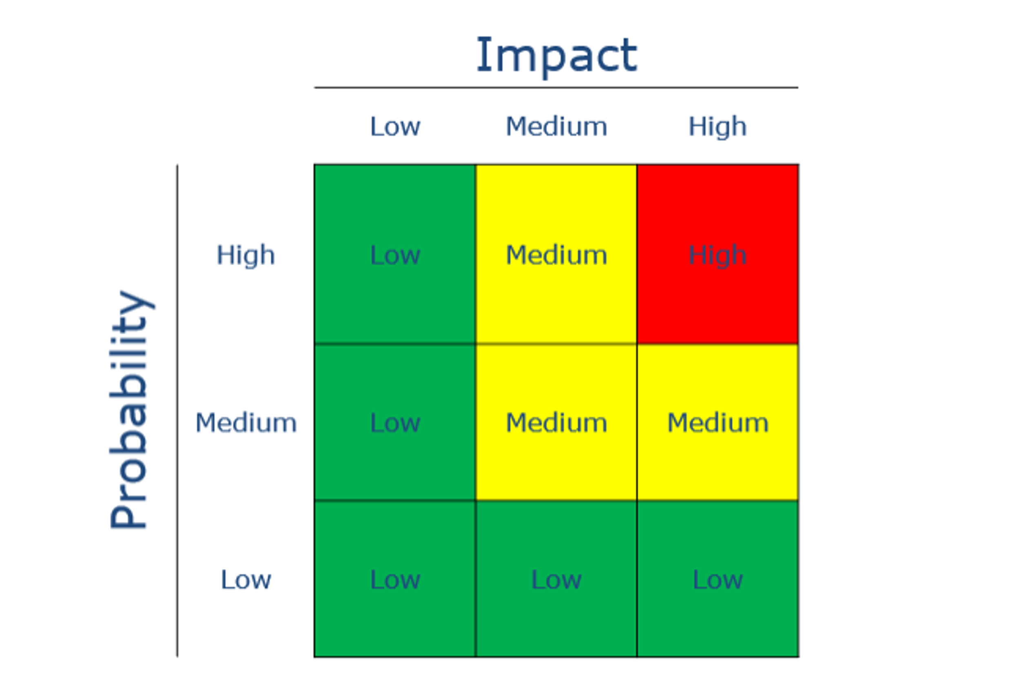

Operational risk: people, the contingency plans, and insurance
Notes:
This picture is like a risk traffic light for projects! It helps people decide how bad and likely a problem could be.
🧩 Two Things It Measures
Impact (Top Row) – how big the problem is if it happens.
Low: just a small bump in the road
Medium: slows you down a bit
High: a big crash — serious trouble
Probability (Side Column) – how likely it is to happen.
Low: almost never
Medium: could happen sometimes
High: pretty likely
🟩🟨🟥 The Colors
🟩 Green = Low Risk → Nothing to worry much about
🟨 Yellow = Medium Risk → Keep an eye on it
🟥 Red = High Risk → Fix it fast!
When a box turns red, that means something could go wrong and hurt the project badly.
⚙️ Operational Risk Example
This one is called Operational Risk — it’s all about how your team runs things. It includes:
👩‍💼 People – are they trained and healthy?
📋 Contingency Plans – what’s the backup plan if something fails?
🛡️ Insurance – do you have protection if something bad happens?
If your people aren’t ready, plans are missing, or insurance is weak, your red box lights up 🔴.

Slide 27








Will customers pay?
How much will they pay?
How much will it cost you to get them to pay
Revenue risk
How will you find them?
Will they repeat purchase?
Will they tell others
Notes:
You have to be careful as people are more eager to talk about negative things!

Slide 28




Will customers pay?
Can you prove it (lean experiments)
Who are the customers?
Is it just market surveys or do you have a list of pre-payments?
Have you done/ Can you do a kickstarter?
When do they pay?
How do we finance the sale? (Do we need inventory and stock?)

Slide 29





How did you work out pricing?
What are ‘approval’ levels of pricing?
How much will they pay?
Can you provide proof that they will pay this?
What experiments can you design to test pricing limits?
Are you charging cost + or a price that reflects benefits

Slide 30






How much will it cost you to get them to pay?
Transaction costs involved
How will you get each customer (growth driver)
Conferences – great for awareness. Very expensive sales channel
Social media – can you demonstrate model
Sales force/ person (expensive) – add to cost of customer acquisition
Word of mouth - can you demonstrate growth model

Slide 31





Does your model rely on people buying your solution or using it more than once?
Have you done experiments around usage?
Will they repeat purchase?
Have you invested in the user experience?
Do you have data that shows repeat usage?
This will increase the lifetime value of client

Slide 32




This brings down cost of customer acquisition
Critical in driving profitability and driving market share
Will they tell others?
How can you make it easy for them to tell others?
Apple/ Bose

Slide 33
Customer Discovery!
The path to getting all your answers.

Slide 34




At the heart of everything you do
Why?
Why do we put ourselves through this?
Vital to master
You need to do a lot of customer discovery
Practice makes perfect

Slide 35






What, Why, and a bit of How
ABOUT GAINING MUCH DEEPER INSIGHT INTO YOUR CUSTOMER, OR MARKET
SEEING BEHAVIOR THAT VALIDATES BUYING WILLINGNESS IS PRICELESS
RIGHT QUESTIONS DEPEND ON UNDERSTANDING AND LISTING EACH ASSUMPTION IN YOUR MODEL
TAKE GREAT NOTES
ANALYSE RESULTS AS A TEAM
PLAY THE DEVIL'S ADVOCATE
Notes:
In customer discovery, “playing the devil’s advocate” means pretending to disagree with your own idea — on purpose — to see if it really holds up.
Here’s how to think about it in simple terms 👇
😈 What It Means
Imagine you’re building a new robot toy and you think it’s amazing 🤖. Now you pretend to be someone who doesn’t like it at all. You start asking hard questions like:
“Why would anyone buy this instead of a cheaper toy?”
“What if kids find it too complicated?”
“Is the battery life too short?”
You’re not trying to be mean — you’re testing your idea from every angle.
💡 Why It’s Important
In customer discovery, this helps you:
Find weak spots in your idea early.
Understand real customer objections before they happen.
Make your solution stronger by fixing those issues.
🧠 Example
If you’re interviewing customers and they say “I love your product!”, you might play the devil’s advocate and ask:
“Really? Some people told me it’s too expensive — what do you think?”
That makes them think harder and give you honest feedback, not just polite answers.
⚖️ In Short:
🗣️ Playing the devil’s advocate = asking tough “what if” questions to test your idea’s strength — before the real world does.

Slide 36
Target customer
Problem customer wants solved Why can’t it be solved today?
Outcome/ value they want to see
Examples
Customer acquisition tactic
Revenue model
Competition and advantages over them Biggest financial risks
Biggest technical/ engineering risks What would make business fail?

Slide 37







Finding Interviewees
Where are they when they feel the moment of pain?
Must have a degree of separation
Ask for and use referrals
Conferences, LinkedIn, Interview for blog article
Use Exec Assistants wisely
Offer to share results from research
Cold calls and emails
Notes:
Always ask people with honest and different questions as the are bombarded with scams and finding a real person is so heartwarming for them. They will always answer you in that way.

Slide 38



The interview
Recognise and remove your biases
Get them to tell you a story
Are they trying to solve problem? How?

Slide 39



Listen…
The interview
Drill down – be an interviewer
Repeat and confirm (or deny and confirm)

Slide 40
Recap
Risks
Customer Discovery

Slide 41
Thank you

